Slide 1

LECTURE 9: WRITING PRACTICE
QUESTIONS: 6-7 (PART 2)

Slide 2
Writing questions 6-7: Respond to a written request
You will read an e-mail and respond to it.
You will be given specific tasks for each response. You may be asked to provide information, ask questions, make a request or suggestion, or explain a problem.
You will have ten minutes to read each e-mail and write your response to it.

Slide 3
Question Types
You will be given specific tasks to address in each response. The tasks will be relevant to the e-mail and may be worded such as the following:
  Ask THREE questions.
  Make TWO requests for information.
  Make ONE suggestion.
  Give TWO pieces of information.
  Explain ONE problem.

Slide 4
A good response…
addresses all the tasks;
has a variety of sentences;
has logically organized ideas;
contains few or no grammar or vocabulary errors.

Slide 5
Things to remember…
Begin your e-mail with an appropriate introduction.
Keep your audience in mind. You may be responding to an e-mail from a boss, a job hunter, a repairperson, or someone else. Use language appropriate for the audience.
Be sure to address all the tasks in your response.

Slide 6
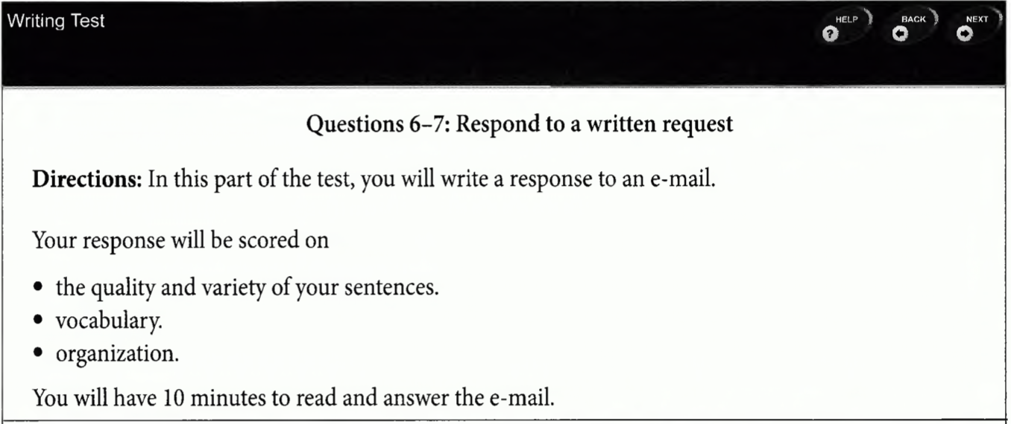
Example

Slide 7
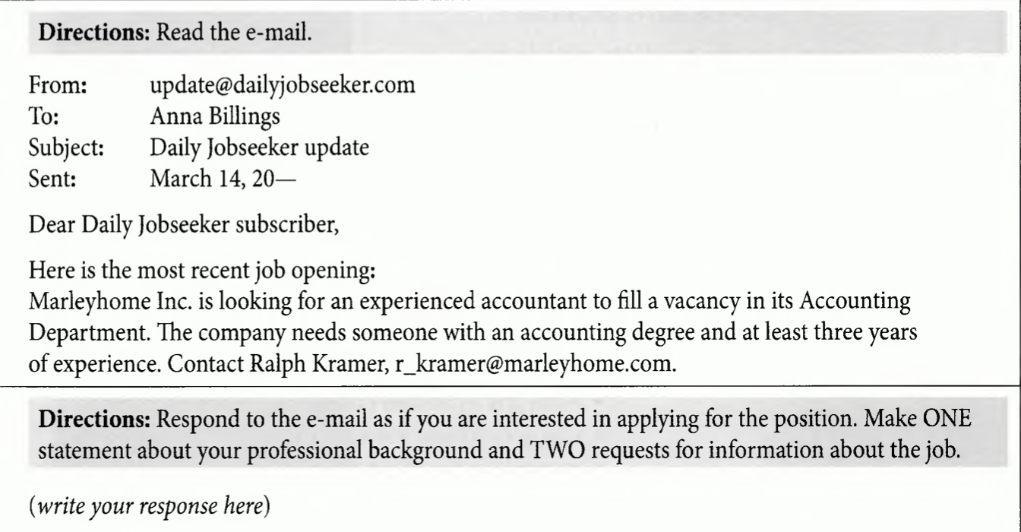
Example

Slide 8
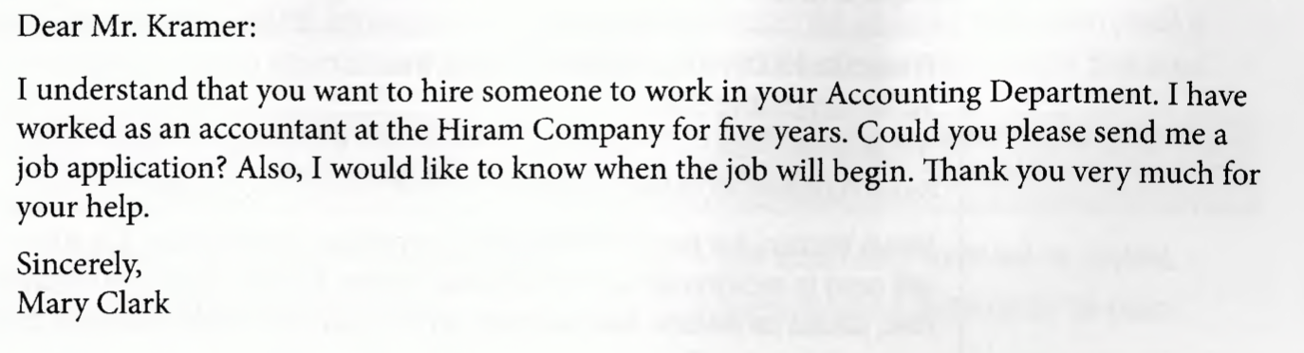
Sample response

Slide 9
Understanding the emails and the questions
Tip 1: Quickly identify the subject of the e-mail.
  You should practice quickly identifying what the subject of an e-mail is.
  Always look first at the header at the top of the e-mail. A header includes:
    The sender, the sender’s e-mail address, and often the sender’s title or company
    The date
    The subject of the email
    The recipient (who the e-mail is sent to).

Slide 10
Understanding the emails and the questions
Tip 1: Quickly identify the subject of the e-mail.
  In many cases, the subject line in the header will tell you much of what you need to know. Always search in this order: (1) subject line, (2) directions, (3) body of the message.

Slide 11
Understanding the emails and the questions
Tip 2: Read the directions carefully.
  The directions provide you with key information about what to include in your response:
The directions provide important information about:
  the role you should play in your response.
  three specific tasks that you must address in your response.

Slide 12
Understanding the emails and the questions
Tip 2: Read the directions carefully.
  The tasks described in the directions vary and may involve:
    requests for more information
    specific actions
    discussion of a problem.
    a description of something
    instructions
    an opinion

Slide 13
STRUCTURING YOUR RESPONSE
TIP 1 Learn the basic template for a successful response.
TIP 2 Learn common language used to respond.

Slide 14
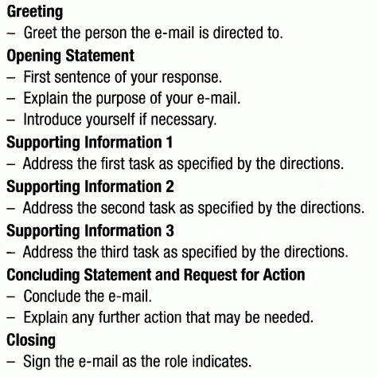
TIP 1 Learn the basic template for a successful response.
Good response will usually include these parts:

Slide 15
TIP 2 Learn common language used to respond.
You should familiarize yourself with the language that is typically used in responses for Questions 6 and 7.
Remember that you will want to use more or less formal language, depending to whom the response is addressed.
  if your response is addressed to someone with a higher position (such as a manager or an owner), you should use more formal language.
  if your response is addressed to a co-worker or peer, you should use less formal language.

Slide 16
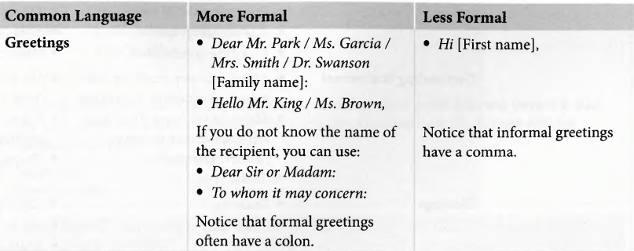
Examples of common language for responses

Slide 17
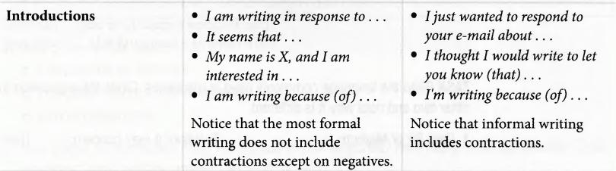
Examples of common language for responses

Slide 18
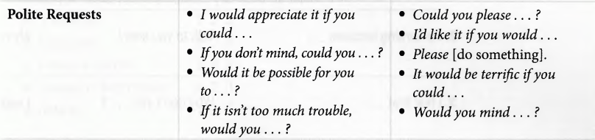
Examples of common language for responses

Slide 19
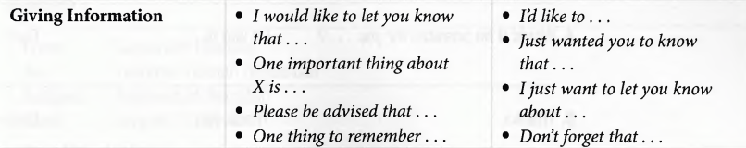
Examples of common language for responses

Slide 20
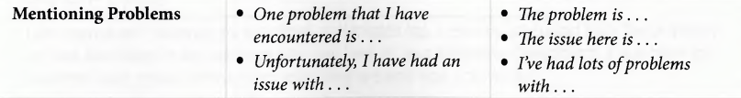
Examples of common language for responses

Slide 21
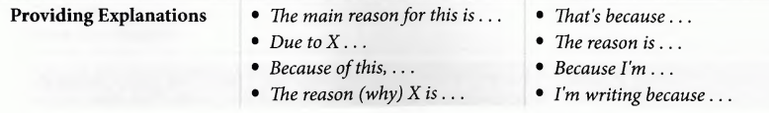
Examples of common language for responses

Slide 22
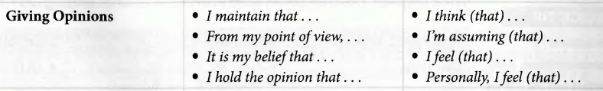
Examples of common language for responses

Slide 23
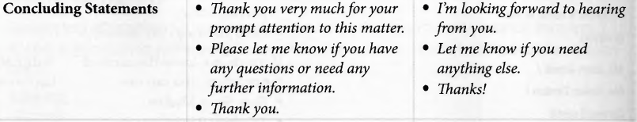
Examples of common language for responses

Slide 24
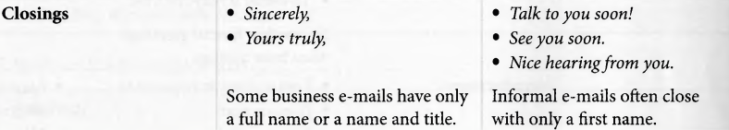
Examples of common language for responses

Slide 25
THANK YOU FOR YOUR ATTENTION!

